Slide 1
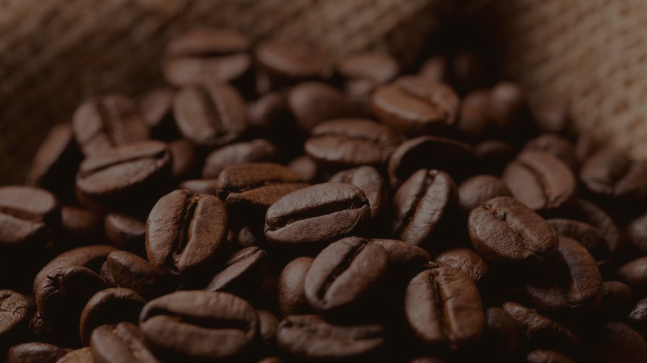
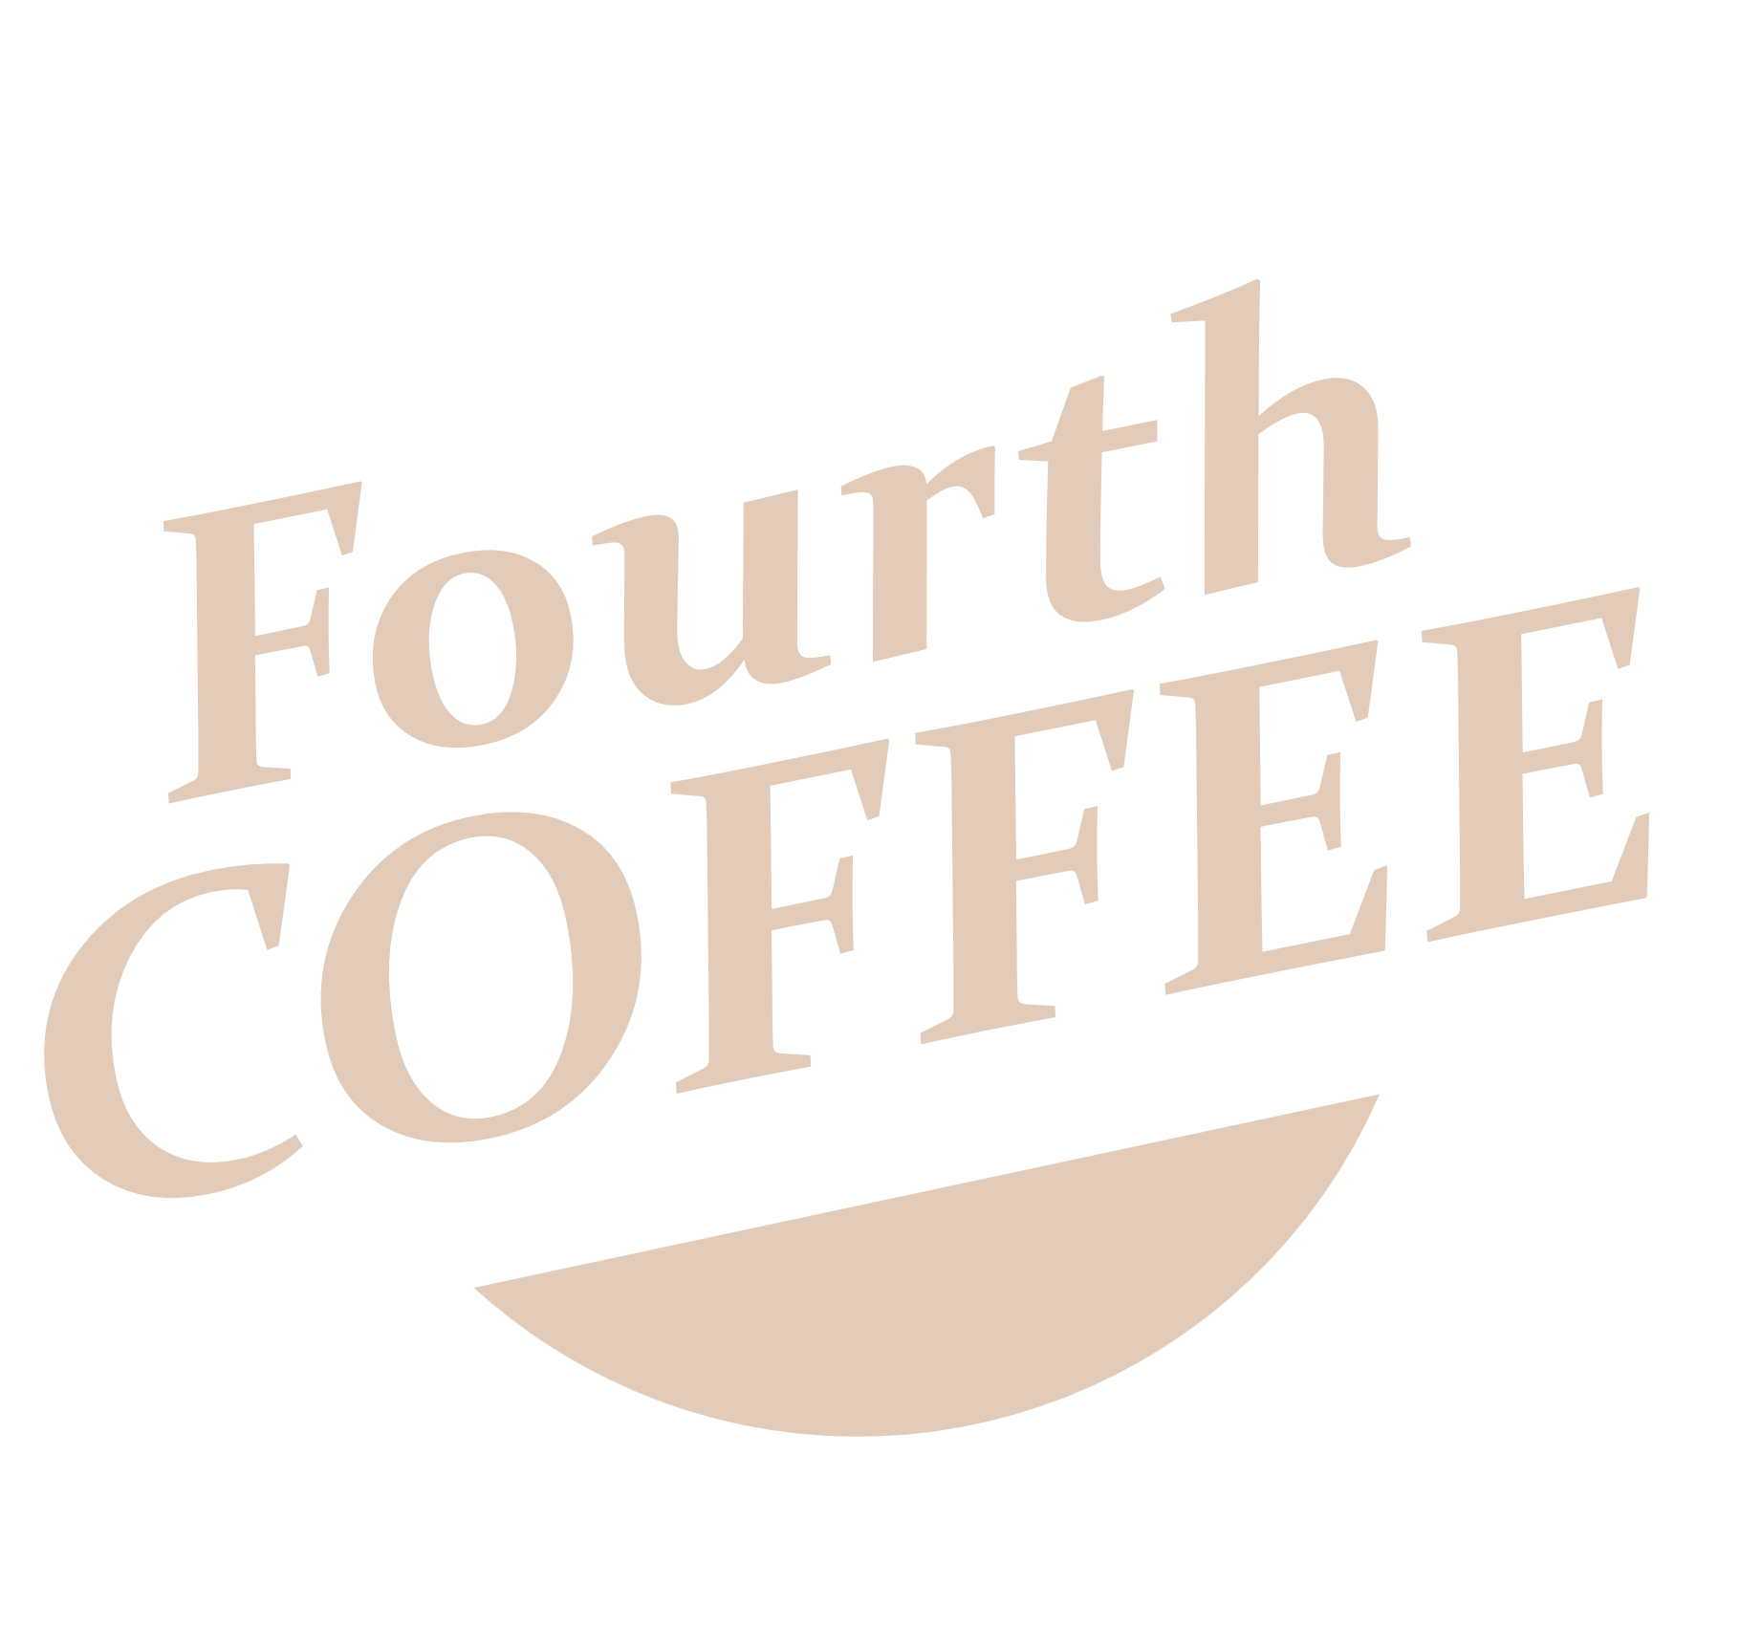
Investor Opportunity

Slide 2
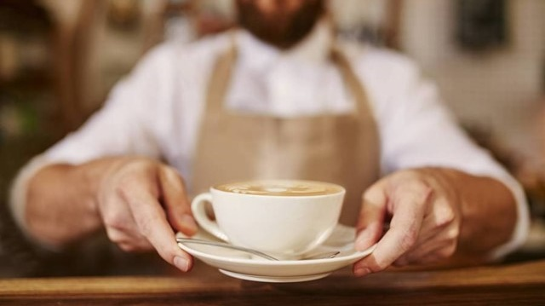
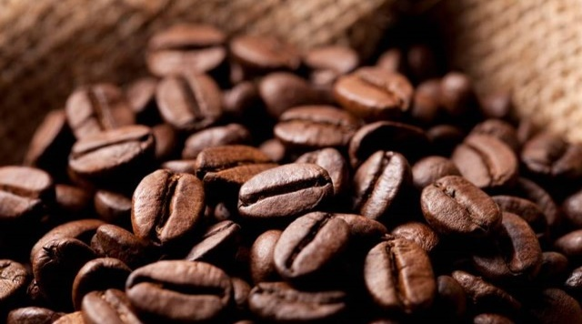
The Big
Buzz
Fourth Coffee’s mission is to become a recognized leader in our target market for providing outstanding premium bagged coffees and specialty coffee beverages.

Slide 3

Industry Outlook
20,000
$10B
85%
$50,000
10%
Shops in the USA
In combined revenue
Average gross margin
In revenue per worker
Revenue increase per year
Success

Slide 4
The Market
Customer Segmentation
21%
36%
29%
7%
7%
Local residents
Tourists
Passing travelers
Students
Local businesses
CUSTOMERS | GROWTH | YR1 | YR2 | YR3
Local residents | 2% | $15,000 | $15,300 | $15,606
Tourist | 5% | $25,000 | $26,250 | $27,563
Passing travelers | 5% | $20,000 | $21,000 | $22,050
Students | 1% | $5,000 | $5,050 | $5,101
Local businesses | 1% | $5,000 | $5,050 | $5,101
TOTAL | 2.8% | $70,000 | $72,650 | $75,420

Slide 5
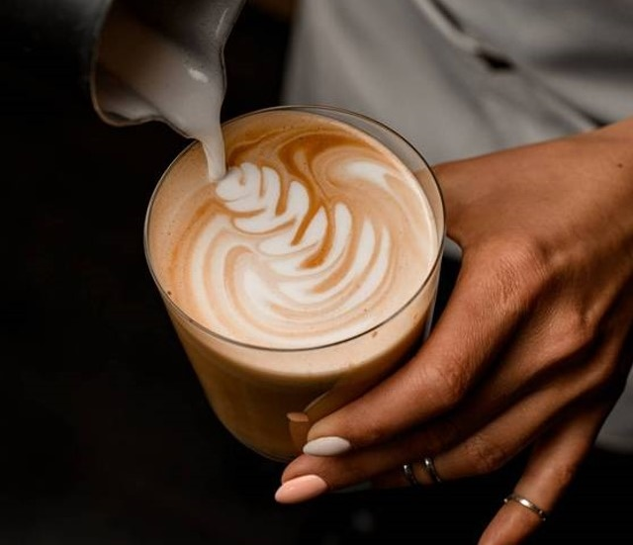



Revenue model
Gourmet coffee beans
Signature coffee beverages
100% fair-trade guaranteed

Slide 6
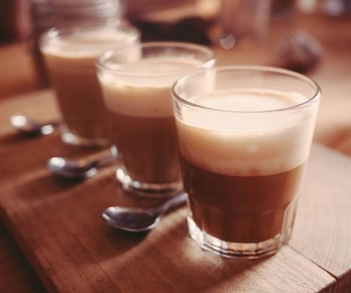
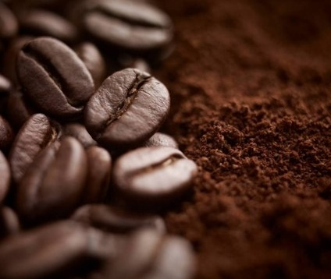

Gourmet coffee beans
100% fair trade guaranteed
35 to 40 different varieties
Differing flavors, brew strengths, and from different regions
Specialized by the pound
Ranging $4.00 to $40.00 per pound
Average $15.00 per pound
Customers can choose beans or freshly ground
Direct sale of food products
Locally sourced
Reputable and recognizable vendor and/or chefs
May include sandwiches, bagels, burritos, pastries, and cookies
Signature coffee beverages
Variety of coffee beverages
Three different size cups
Priced from $2.50 for a 12-ounce drip coffee to $5.75 for a 20-ounce latte
Provides a steady and reliable source of income
Highly predicable and high margin

Slide 7
Sales forecast
3 YEAR SALES SUMMARY | YR1 | YR2 | YR3
TOTAL SALES | $702,000 | $772,200 | $849,420
TOTAL COGS | $212,000 | $222,600 | $233,730
NET PROFIT | $490,000 | $549,600 | $615,690

Slide 8

KEY TIMELINE GOALS
 | 2/1/XX | 5/12/XX | 8/20/XX | 11/28/XX
Business / Marketing Plan
Secure funding
Build Out
Grand opening
Achieve 700+ daily customers

Slide 9
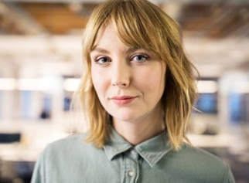


The Team
Manager
Remy Morris
Owner
Sonu Jain
Key Employee
Noa Vidal

Slide 10
Business Ratios
FINANCIAL RATIOS | YR1 | YR2 | YR3
Profit margin | 12.07% | 14.95% | 17.66%
Assets to liabilities | 2.83 | 4.24 | 7.44
Equity to liabilities | 1.83 | 3.24 | 6.44
Assets to equity | 1.55 | 1.31 | 1.16
LIQUIDITY RATIOS | YR1 | YR2 | YR3
Acid test | 2.34 | 3.66 | 6.67
Cash to assets | 0.83 | 0.86 | 0.90

Slide 11
Business Ratios

Slide 12
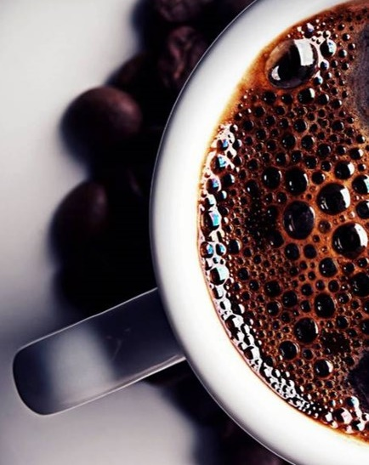
Major Competitors
Rocket Boy Coffee – 1 mile
Started the specialty coffee chain phenomena in America in 1982. 99% are company owned. Revenues exceeded $6 billion in 2002. Average store gross revenue is $805,000. Now in 30 countries. Same store sales increased by 10% in 2002.
Hyperwarp Coffee – 2 miles
Second largest all company-owned chains. Founded in 1992 in Minneapolis.
Express Espresso – 400 feet
The third largest company-owned chain. Another Seattle-born company. The only coffeehouse chain that has not experienced excellent growth every year; business.com cites poor management as the reason. New management seems to be leading a turnaround.

Slide 13
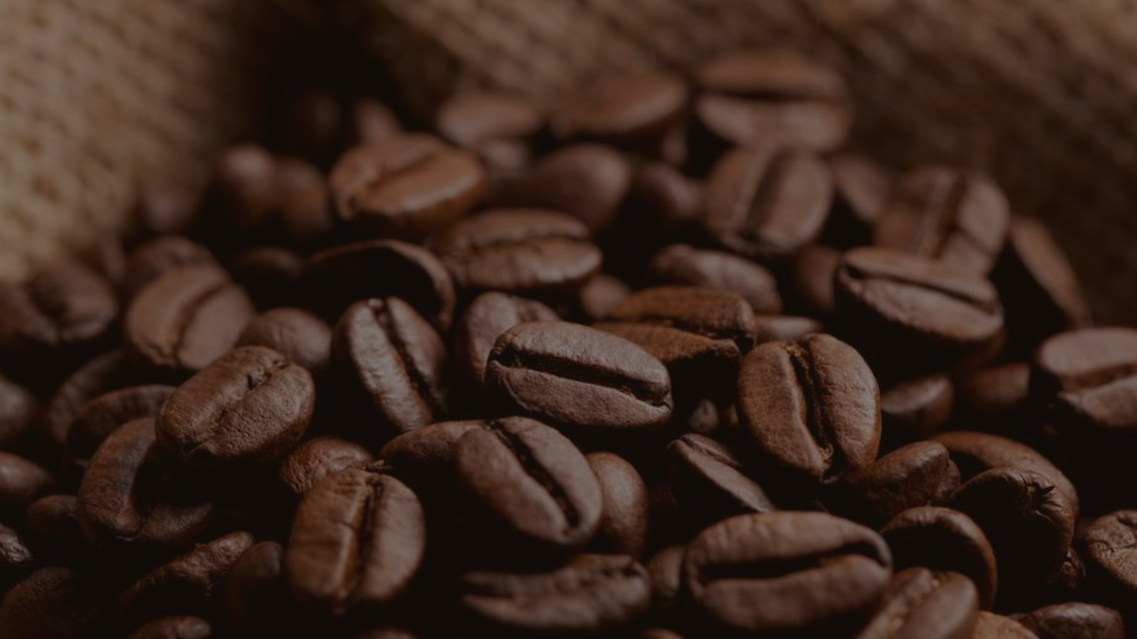
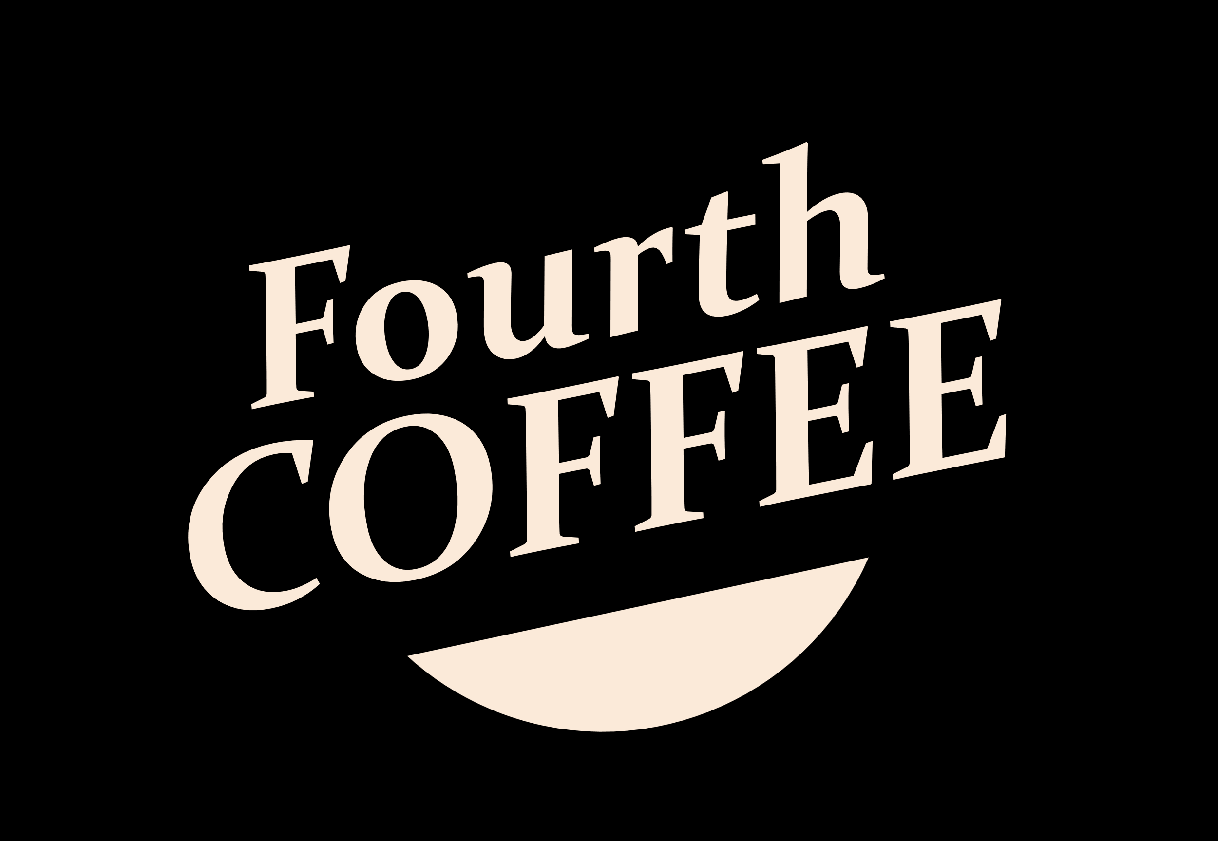
Thank you
Contact us at
Sonu Jain
sonu@fourthcoffee.com
405-555-0145

